Slide 1
Introduction to IoT
Prepared By:
Partha Dip Sarkar
Lecturer(CSE), DIU

Slide 2
Contents
Introduction to IoT
IoT and its importance
Elements & Characteristics
Influence of IOT in 4.0 IR
Sensors, Actuators, Physical Design of IoT
Embedded Systems
IoT Levels and Templates
Domain Specific IoTs
Home automation, Industry applications, Agriculture, Surveillance applications
IoT applications for industry:
Future Factory Concepts, Green vs Brown Field of IoT, Smart Objects.

Slide 3
IoT and its importance
What is IoT?
IoT or Internet of things describes physical objects that are embedded with sensors, processing ability, software, and other technologies that connect and exchange data with other devices and systems over the Internet or other communications networks
Importance?
Live smarter, automate home and business, reduce cost
Notes:
The internet of things helps people live and work smarter, as well as gain complete control over their lives. In addition to offering smart devices to automate homes, IoT is essential to business. IoT provides businesses with a real-time look into how their systems really work, delivering insights into everything from the performance of machines to supply chain and logistics operations.
IoT enables companies to automate processes and reduce labor costs. It also cuts down on waste and improves service delivery, making it less expensive to manufacture and deliver goods, as well as offering transparency into customer transactions.

Slide 4
Elements & Characteristics of IoT
Elements of IoT
4 fundamental components of IoT system,
Sensors/Device
Connectivity
Data Processing
UI
Characteristics of IoT
6 basic characteristics
Connectivity
Intelligence and Identity
Scalability
Dynamic and Self-Adapting (Complexity)
Architecture
Safety
Notes:
https://data-flair.training/blogs/how-iot-works/
Characteristics of the Internet of Things : There are the following characteristics of IoT as follows. Let’s discuss it one by one.
Connectivity – Connectivity is an important requirement of the IoT infrastructure. Things of IoT should be connected to the IoT infrastructure. Anyone, anywhere, anytime can connectivity should be guaranteed at all times Without connection, nothing makes sense.
Intelligence and Identity – The extraction of knowledge from the generated data is very important. For example, a sensor generates data, but that data will only be useful if it is interpreted properly. Each IoT device has a unique identity. This identification is helpful in tracking the equipment and at times for querying its status.
Scalability – The number of elements connected to the IoT zone is increasing day by day. Hence, an IoT setup should be capable of handling the massive expansion. The data generated as an outcome is enormous, and it should be handled appropriately.
Dynamic and Self-Adapting (Complexity) – IoT devices should dynamically adapt themselves to the changing contexts and scenarios. Assume a camera meant for the surveillance. It should be adaptable to work in different conditions and different light situations (morning, afternoon, night).
Architecture – IoT architecture cannot be homogeneous in nature. It should be hybrid, supporting different manufacturers ‘ products to function in the IoT network. IoT is not owned by anyone engineering branch. IoT is a reality when multiple domains come together.
Safety – There is a danger of the sensitive personal details of the users getting compromised when all his/her devices are connected to the internet. This can cause a loss to the user. Hence, data security is the major challenge. Besides, the equipment involved is huge. IoT networks may also be at the risk. Therefore, equipment safety is also critical.
References : https://en.wikipedia.org/wiki/Internet_of_things

Slide 5
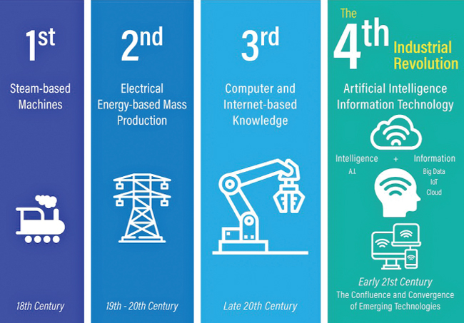
Influence of in 4th Industrial Revolution
The Fourth Industrial Revolution is data-driven. And a primary reason for this is the rise of the internet of things (IoT). Connected devices from the consumer level to the industrial are creating—and consuming—more data than ever before.
Notes:
https://www.forbes.com/sites/kinetica/2019/05/31/the-internet-of-things-is-powering-the-data-driven-fourth-industrial-revolution/?sh=4506cd9324e8

Slide 6
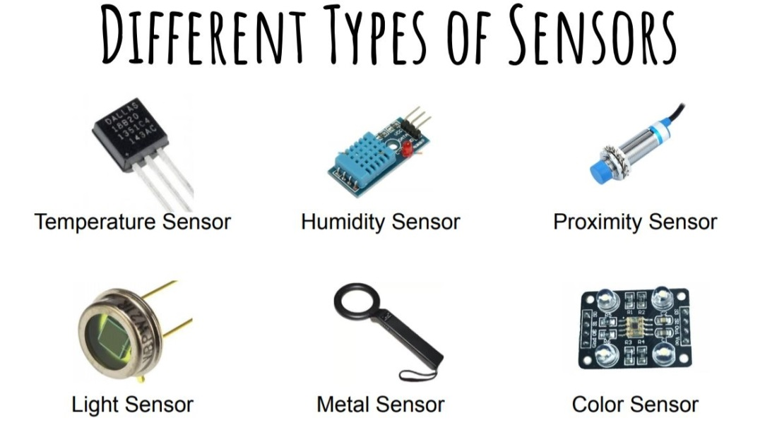
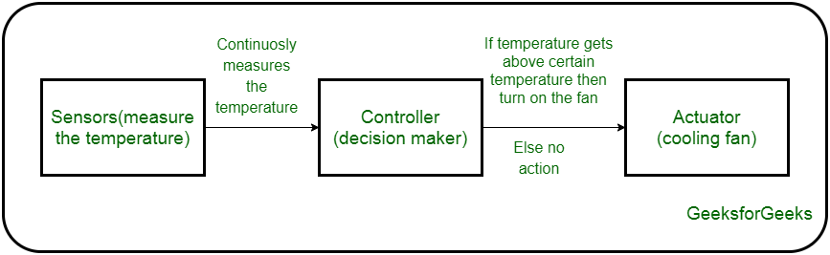
Sensors, Actuators, Physical Design of IoT
A sensor is a device that detects and responds to some type of input from the physical environment. The specific input could be light, heat, motion, moisture, pressure, or any one of a great number of other environmental phenomena.
An actuator is a machine component or system that moves or controls the mechanism or the system.
An IoT device is made up of a Physical object (“thing”) + Controller (“brain”) + Sensors + Actuators + Networks (Internet)
Notes:
Sensors in the device sense the environment, then control signals are generated for the actuators according to the actions needed to perform.
A servo motor is an example of an actuator.

Slide 7
Embedded Systems
An embedded system is a computer system—a combination of a computer processor, computer memory, and input/output peripheral devices—that has a dedicated function within a larger mechanical or electronic system
IoT is embedded system that connects to internet. Embedded systems are not updated after they are shipped to customer but IoT may be updated with time.
Notes:
https://simplicable.com/new/iot-vs-embedded-systems#:~:text=Embedded%20systems%20are%20computer%20hardware,are%20embedded%20into%20everyday%20things.

Slide 8
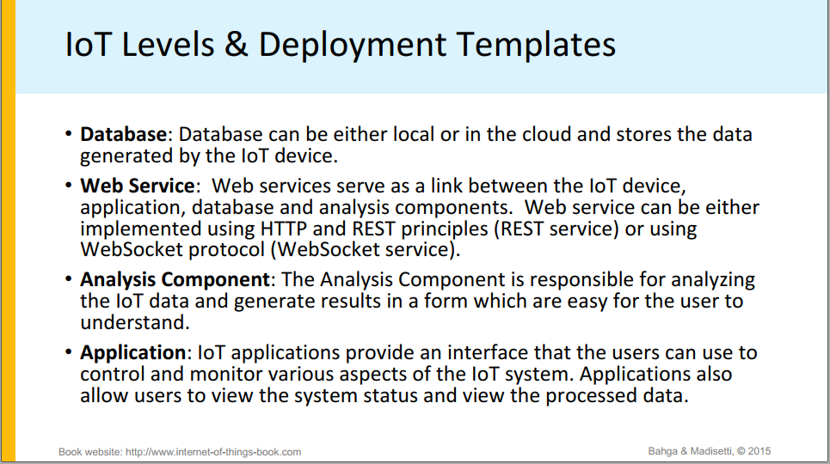

Slide 9
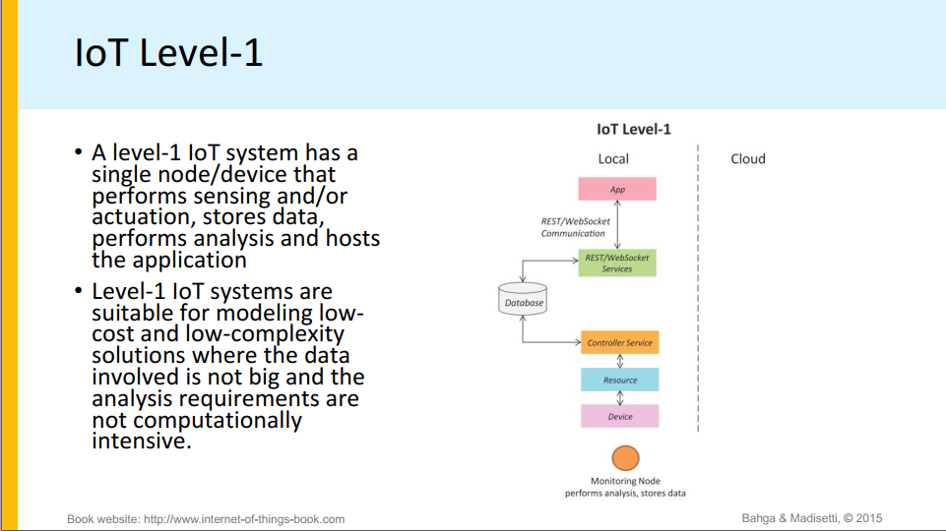
Notes:
https://www.youtube.com/watch?v=k_DVJlrZg20

Slide 10
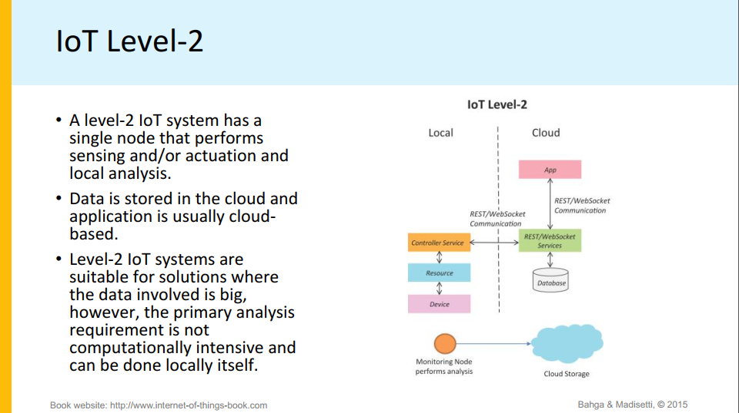

Slide 11
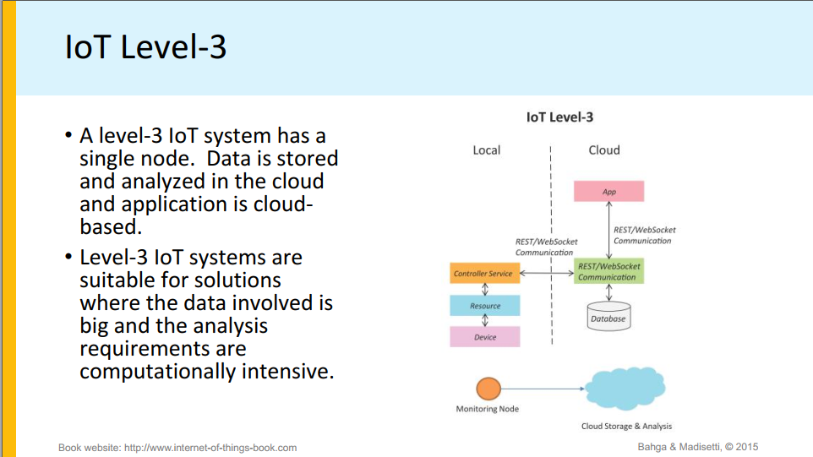

Slide 12
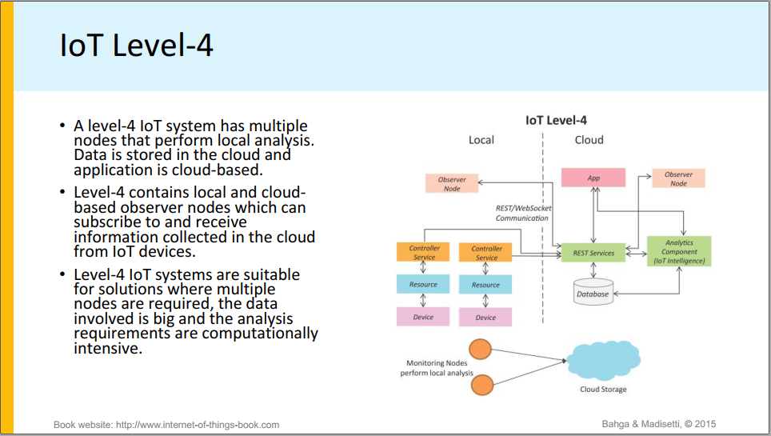

Slide 13
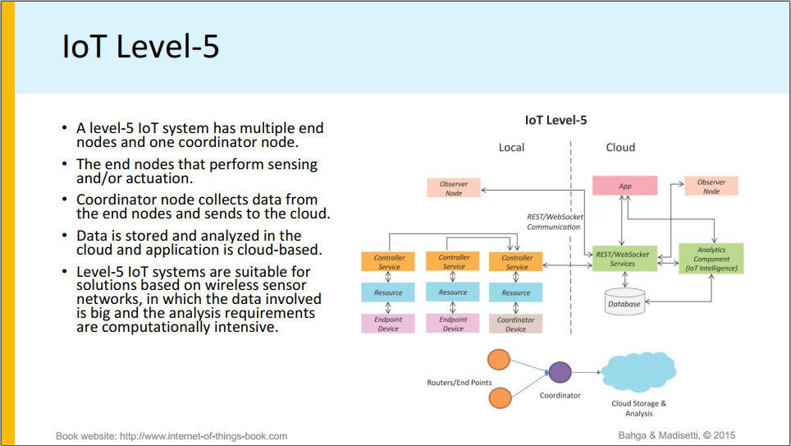

Slide 14
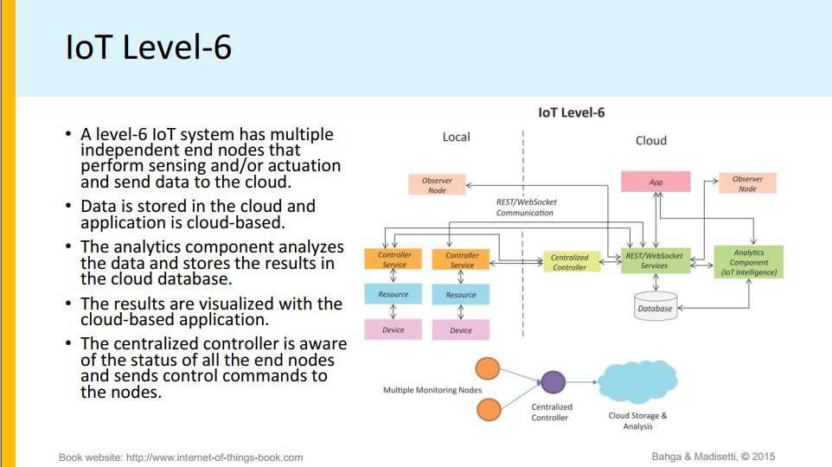

Slide 15
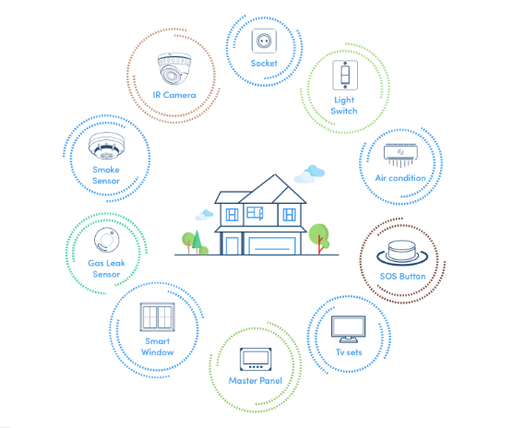
Domain Specific IoTs: Home automation
IoT home automation is the ability to control domestic appliances by electronically controlled, internet-connected systems.
Notes:
https://www.fracttal.com/en/blog/the-9-most-important-applications-of-the-internet-of-things

Slide 16
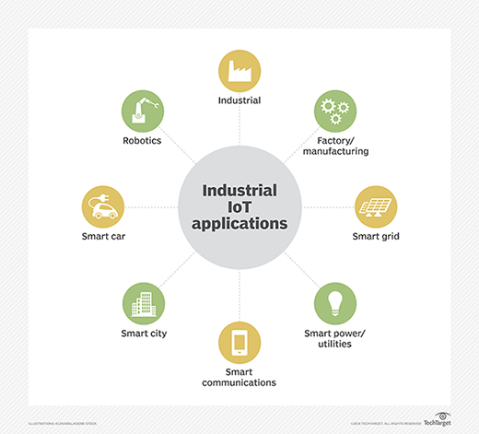
Domain Specific IoTs: Industrial application
The industrial internet of things refers to interconnected sensors, instruments, and other devices networked together with computers' industrial applications, including manufacturing and energy management.
Notes:
https://www.fracttal.com/en/blog/the-9-most-important-applications-of-the-internet-of-things

Slide 17
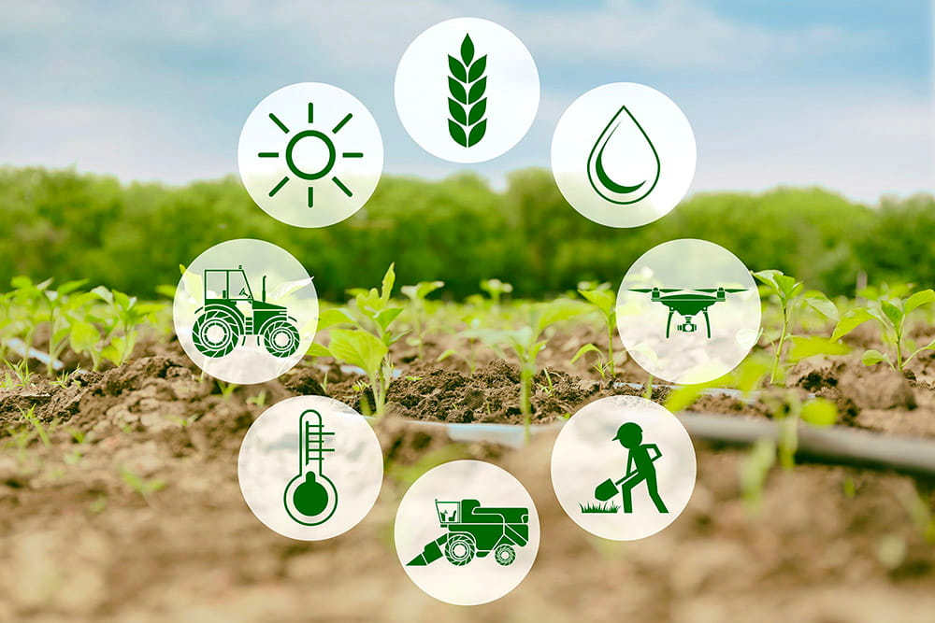
Domain Specific IoTs: Agriculture
On farms, IOT allows devices across a farm to measure all kinds of data remotely and provide this information to the farmer in real time. IOT devices can gather information like soil moisture, chemical application, dam levels and livestock health - as well as monitor fences vehicles and weather.
Notes:
https://www.fracttal.com/en/blog/the-9-most-important-applications-of-the-internet-of-things

Slide 18
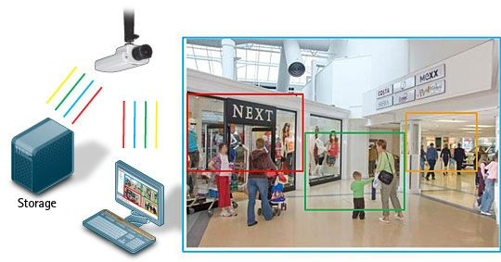
Domain Specific IoTs: Surveillance
Video surveillance capabilities are enhanced by IoT technology. Smart cameras and connected applications can process visual information without human intervention, opening the door for the adoption of many automated processes.
Notes:
https://www.ifsecglobal.com/video-surveillance/smart-cctv-and-the-internet-of-things-2016-trends-and-predications/

Slide 19
Future Factory Concepts
Industrial Internet of Things(IIoT) in manufacturing & Smart Factories
Widely applied in sourcing and production, assembly and packaging, warehousing and supply chain management, IIoT solutions enable a fully-connected factory where information and operational commands can be directly sent to suppliers, manufacturers and distributors. Smart factories can achieve improved manufacturing efficiency and quality, enhanced human activity support and reduced energy consumption and costs. Many industrial and tech companies are venturing into IIoT product development, aiming to bring innovative IIoT solutions to smart manufacturing.
Notes:
https://medium.com/syncedreview/industrial-internet-of-things-factories-of-the-future-fa7c4215d37c

Slide 20
Green vs Brown Field of IoT
Greenfield IoT development : In software development, greenfield refers to software that is created from scratch in a totally new environment. No constraints are imposed by legacy code, no requirements to integrate with other systems.
Brownfield IoT development :Again, to take the cue from software development, brownfield development refers to any form of software that created on top of legacy systems or with the aim of coexisting with other software that are already in use. This will impose some constraints and requirements that will limit design and implementation decisions to the developers. The development process can become challenging and arduous and require meticulous analysis, design and testing, things that many upstart developers don’t have the patience for.
Notes:
https://bdtechtalks.com/2016/09/22/what-is-the-difference-between-greenfield-and-brownfield-iot-development/

Slide 21
Smart Objects
The concept of smart in IoT is used for physical objects that are active, digital, networked, can operate to some extent autonomously, reconfigurable and has local control of the resources. The smart objects need energy, data storage, etc.
A smart object carries blocks of application logic that make sense for their local situation and interact with human users. A smart object sense, log, and interpret the occurrence within themselves and the environment, and intercommunicate with each other and exchange information with people.
Example: Smartphone, Tablet, Smart TV, SmartMat etc.
Notes:
https://www.javatpoint.com/iot-smart-objects

Slide 22
Thank you

